Slide 1
Chapter 5: Other Relational Languages

Slide 2
Chapter 5: Other Relational Languages
Tuple Relational Calculus
Domain Relational Calculus
Query-by-Example (QBE)
Datalog

Slide 3
Tuple Relational Calculus
A nonprocedural query language, where each query is of the form
{t | P (t ) }
It is the set of all tuples t such that predicate P is true for t
t is a tuple variable, t [A ] denotes the value of tuple t on attribute A
t ∈ r denotes that tuple t is in relation r
P is a formula similar to that of the predicate calculus

Slide 4
Predicate Calculus Formula
1. Set of attributes and constants
2. Set of comparison operators: (e.g., <, ≤, =, ≠, >, ≥)
3. Set of connectives: and (∧), or (v)‚ not (¬)
4. Implication (⇒): x ⇒ y, if x if true, then y is true
x ⇒ y ≡ ¬x v y
5. Set of quantifiers:
∃ t ∈ r (Q (t )) ≡ ”there exists” a tuple in t in relation r such that predicate Q (t ) is true
∀t ∈ r (Q (t )) ≡ Q is true “for all” tuples t in relation r

Slide 5
Banking Example
branch (branch_name, branch_city, assets )
customer (customer_name, customer_street, customer_city )
account (account_number, branch_name, balance )
loan (loan_number, branch_name, amount )
depositor (customer_name, account_number )
borrower (customer_name, loan_number )

Slide 6
Example Queries
Find the loan_number, branch_name, and amount for loans of over $1200
{t | t ∈ loan ∧ t [amount ] > 1200}
Find the loan number for each loan of an amount greater than $1200
{t | ∃ s ∈ loan (t [loan_number ] = s [loan_number ] ∧ s [amount ] > 1200)}
Notice that a relation on schema [loan_number ] is implicitly defined by
the query

Slide 7
Example Queries
Find the names of all customers having a loan, an account, or both at the bank
{t | ∃s ∈ borrower ( t [customer_name ] = s [customer_name ]) ∨ ∃u ∈ depositor ( t [customer_name ] = u [customer_name ])
Find the names of all customers who have a loan and an account at the bank
{t | ∃s ∈ borrower ( t [customer_name ] = s [customer_name ]) ∧ ∃u ∈ depositor ( t [customer_name ] = u [customer_name] )

Slide 8
Example Queries
Find the names of all customers having a loan at the Perryridge branch
{t | ∃s ∈ borrower (t [customer_name ] = s [customer_name ] ∧ ∃u ∈ loan (u [branch_name ] = “Perryridge” ∧ u [loan_number ] = s [loan_number ]))}
Find the names of all customers who have a loan at the Perryridge branch, but no account at any branch of the bank
{t | ∃s ∈ borrower (t [customer_name ] = s [customer_name ] ∧ ∃u ∈ loan (u [branch_name ] = “Perryridge” ∧ u [loan_number ] = s [loan_number ])) ∧ not ∃v ∈ depositor (v [customer_name ] = t [customer_name ])}

Slide 9
Example Queries
Find the names of all customers having a loan from the Perryridge branch, and the cities in which they live
{t | ∃s ∈ loan (s [branch_name ] = “Perryridge” ∧ ∃u ∈ borrower (u [loan_number ] = s [loan_number ] ∧ t [customer_name ] = u [customer_name ]) ∧ ∃ v ∈ customer (u [customer_name ] = v [customer_name ] ∧ t [customer_city ] = v [customer_city ])))}

Slide 10
Example Queries
Find the names of all customers who have an account at all branches located in Brooklyn:
{t | ∃ r ∈ customer (t [customer_name ] = r [customer_name ]) ∧
( ∀ u ∈ branch (u [branch_city ] = “Brooklyn” ⇒
∃ s ∈ depositor (t [customer_name ] = s [customer_name ]
∧ ∃ w ∈ account ( w[account_number ] = s [account_number ]
∧ ( w [branch_name ] = u [branch_name ]))))}

Slide 11
Safety of Expressions
It is possible to write tuple calculus expressions that generate infinite relations.
For example, { t | ¬ t ∈ r } results in an infinite relation if the domain of any attribute of relation r is infinite
To guard against the problem, we restrict the set of allowable expressions to safe expressions.
An expression {t | P (t )} in the tuple relational calculus is safe if every component of t appears in one of the relations, tuples, or constants that appear in P
NOTE: this is more than just a syntax condition.
E.g. { t | t [A] = 5 ∨ true } is not safe --- it defines an infinite set with attribute values that do not appear in any relation or tuples or constants in P.

Slide 12
Domain Relational Calculus
A nonprocedural query language equivalent in power to the tuple relational calculus
Each query is an expression of the form:
{ < x₁, x₂, …, x_{n} > | P (x₁, x₂, …, x_{n})}
x₁, x₂, …, x_{n} represent domain variables
P represents a formula similar to that of the predicate calculus

Slide 13
Example Queries
Find the loan_number, branch_name, and amount for loans of over $1200
{< l, b, a > | < l, b, a > ∈ loan ∧ a > 1200}
Find the names of all customers who have a loan of over $1200
{< c > | ∃ l, b, a (< c, l > ∈ borrower ∧ < l, b, a > ∈ loan ∧ a > 1200)}
Find the names of all customers who have a loan from the Perryridge branch and the loan amount:
{< c, a > | ∃ l (< c, l > ∈ borrower ∧ ∃b (< l, b, a > ∈ loan ∧
b = “Perryridge”))}
{< c, a > | ∃ l (< c, l > ∈ borrower ∧ < l, “ Perryridge”, a > ∈ loan)}

Slide 14
Example Queries
Find the names of all customers having a loan, an account, or both at the Perryridge branch:
{< c > | ∃ l ( < c, l > ∈ borrower ∧ ∃ b,a (< l, b, a > ∈ loan ∧ b = “Perryridge”)) ∨ ∃ a (< c, a > ∈ depositor ∧ ∃ b,n (< a, b, n > ∈ account ∧ b = “Perryridge”))}
Find the names of all customers who have an account at all branches located in Brooklyn:
{< c > | ∃ s,n (< c, s, n > ∈ customer) ∧
∀ x,y,z (< x, y, z > ∈ branch ∧ y = “Brooklyn”) ⇒ ∃ a,b (< x, y, z > ∈ account ∧ < c,a > ∈ depositor)}

Slide 15
Safety of Expressions
The expression:
{ < x₁, x₂, …, x_{n} > | P (x₁, x₂, …, x_{n} )}
is safe if all of the following hold:
All values that appear in tuples of the expression are values from dom (P ) (that is, the values appear either in P or in a tuple of a relation mentioned in P ).
For every “there exists” subformula of the form ∃ x (P₁(x )), the subformula is true if and only if there is a value of x in dom (P₁) such that P₁(x ) is true.
For every “for all” subformula of the form ∀_{x} (P₁ (x )), the subformula is true if and only if P₁(x ) is true for all values x from dom (P₁).

Slide 16
Query-by-Example (QBE)
Basic Structure
Queries on One Relation
Queries on Several Relations
The Condition Box
The Result Relation
Ordering the Display of Tuples
Aggregate Operations
Modification of the Database

Slide 17
QBE — Basic Structure
A graphical query language which is based (roughly) on the domain relational calculus
Two dimensional syntax – system creates templates of relations that are requested by users
Queries are expressed “by example”

Slide 18
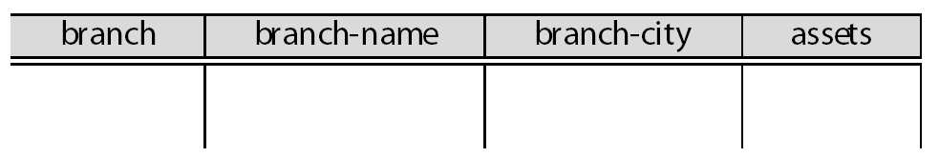
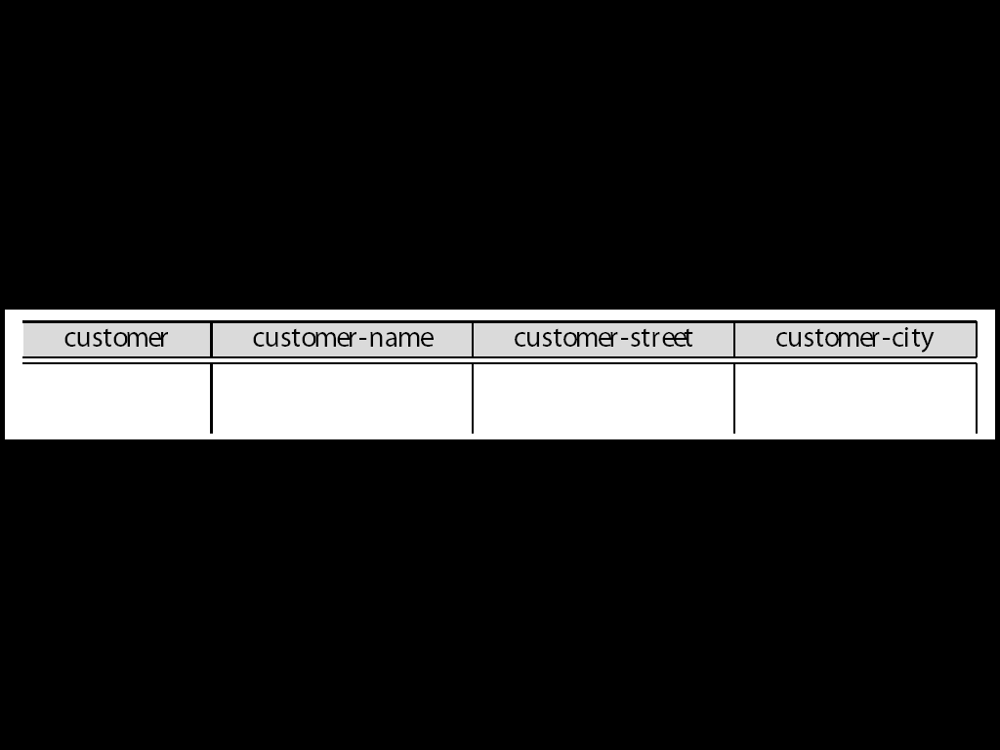
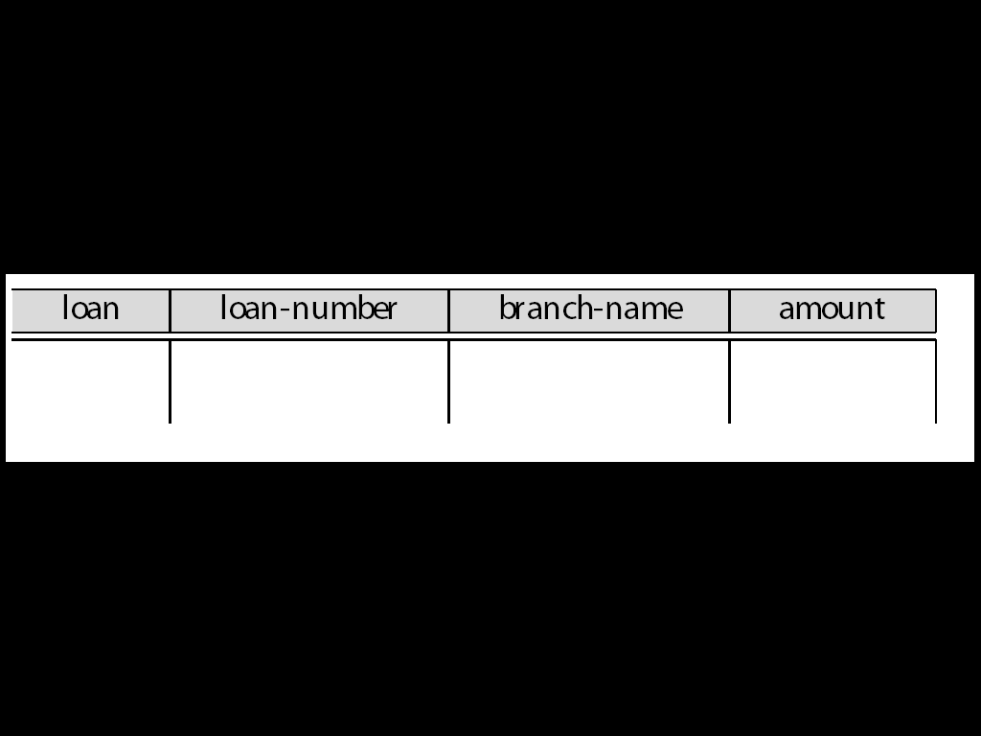
QBE Skeleton Tables for the Bank Example

Slide 19
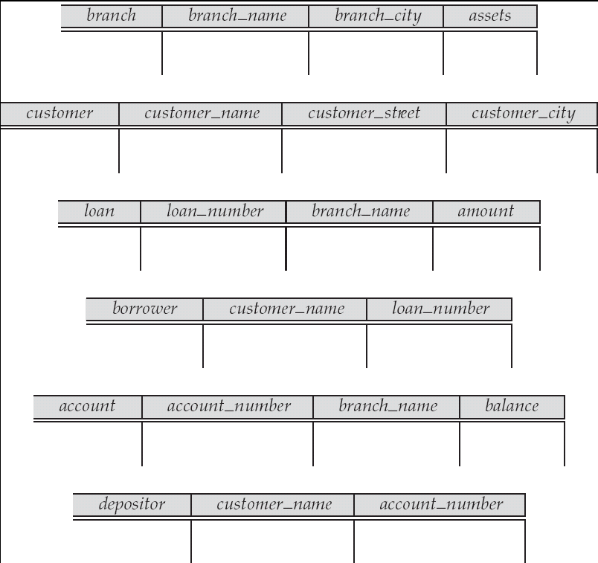
QBE Skeleton Tables (Cont.)

Slide 20
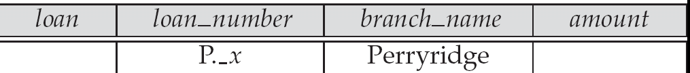

Queries on One Relation
Find all loan numbers at the Perryridge branch.
_x is a variable (optional; can be omitted in above query)
P. means print (display)
duplicates are removed by default
To retain duplicates use P.ALL

Slide 21
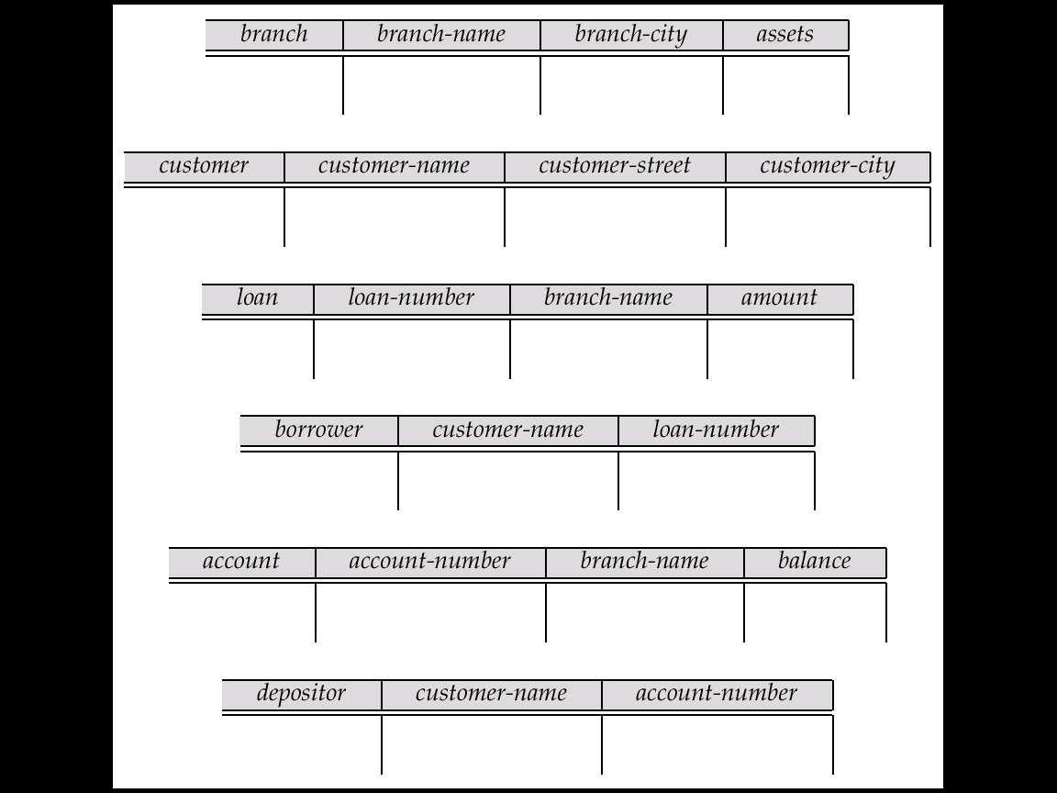
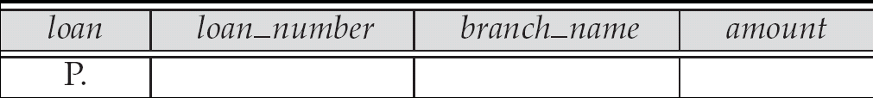
Queries on One Relation (Cont.)
Display full details of all loans
Method 1:
P._x
P._y
P._z
Method 2: Shorthand notation

Slide 22
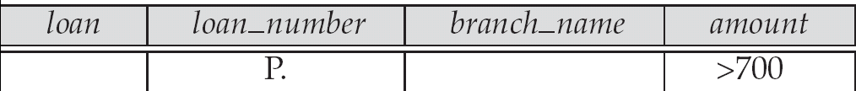
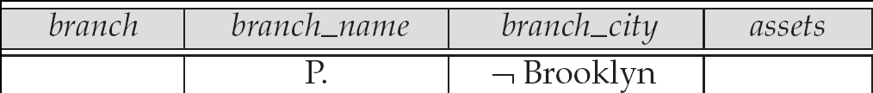
Queries on One Relation (Cont.)
Find the loan number of all loans with a loan amount of more than $700
Find names of all branches that are not located in Brooklyn

Slide 23
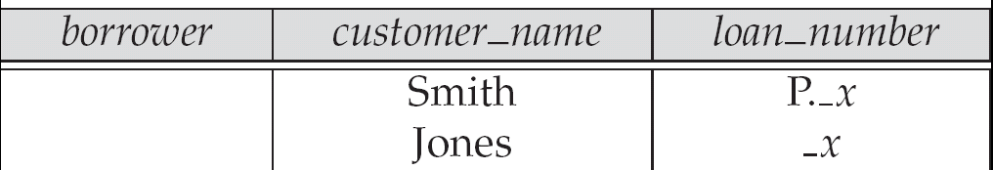
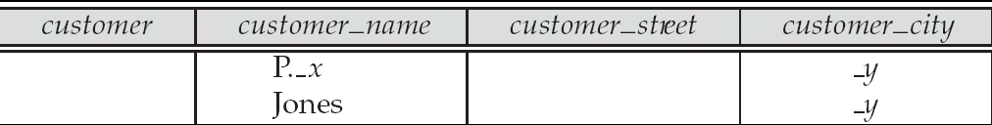
Queries on One Relation (Cont.)
Find the loan numbers of all loans made jointly to Smith and Jones.
Find all customers who live in the same city as Jones

Slide 24
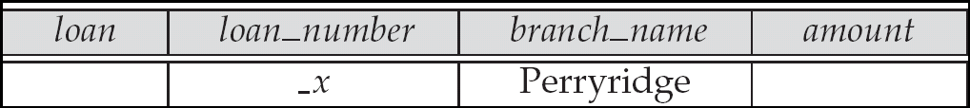
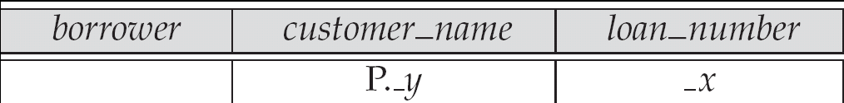
Queries on Several Relations
Find the names of all customers who have a loan from the Perryridge branch.

Slide 25
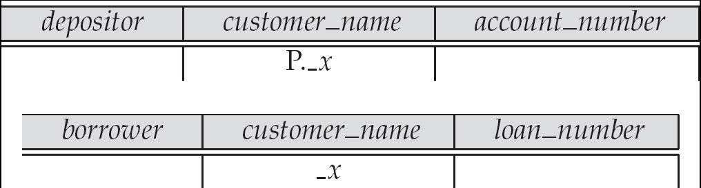
Queries on Several Relations (Cont.)
Find the names of all customers who have both an account and a loan at the bank.

Slide 26
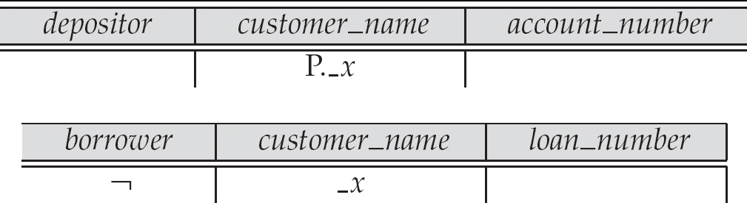
Negation in QBE
Find the names of all customers who have an account at the bank, but do not have a loan from the bank.
¬ means “there does not exist”

Slide 27
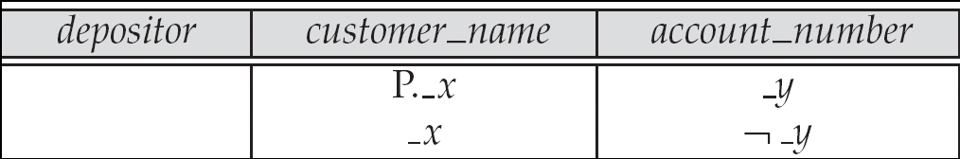
Negation in QBE (Cont.)
Find all customers who have at least two accounts.
¬ means “not equal to”

Slide 28
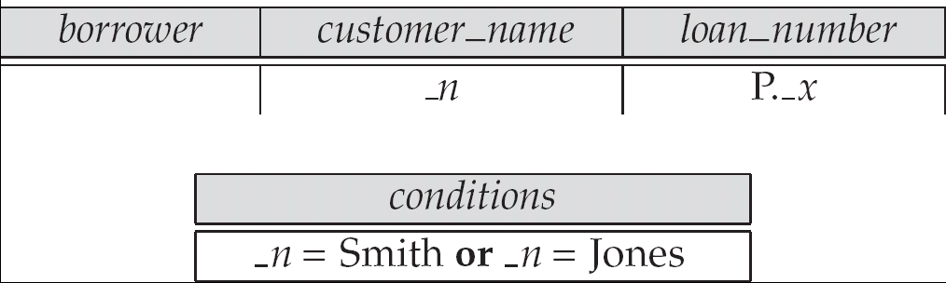
The Condition Box
Allows the expression of constraints on domain variables that are either inconvenient or impossible to express within the skeleton tables.
Complex conditions can be used in condition boxes
Example: Find the loan numbers of all loans made to Smith, to Jones, or to both jointly

Slide 29
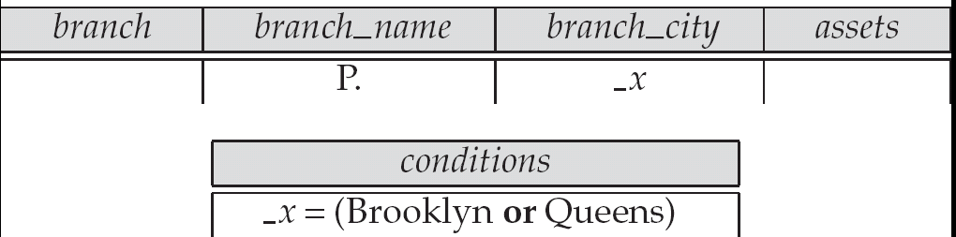
Condition Box (Cont.)
QBE supports an interesting syntax for expressing alternative values

Slide 30
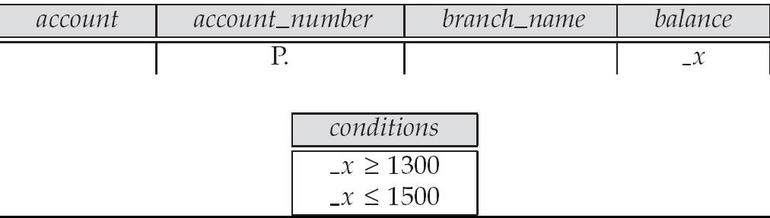
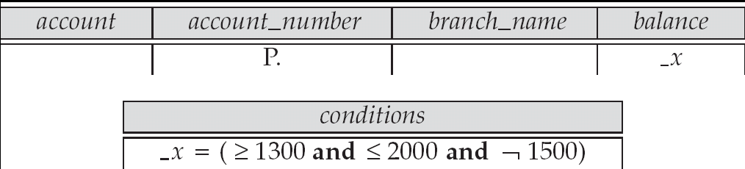
Condition Box (Cont.)
Find all account numbers with a balance greater than $1,300 and less than $1,500
Find all account numbers with a balance greater than $1,300 and less than $2,000 but not exactly $1,500.

Slide 31
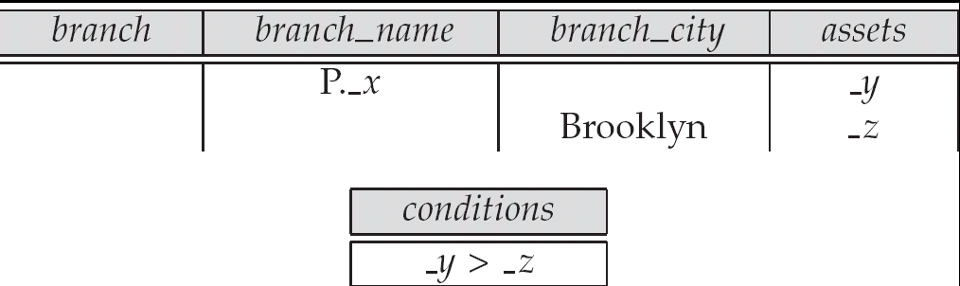
Condition Box (Cont.)
Find all branches that have assets greater than those of at least one branch located in Brooklyn

Slide 32
The Result Relation
Find the customer_name, account_number, and balance for all customers who have an account at the Perryridge branch.
We need to:
Join depositor and account.
Project customer_name, account_number and balance.
To accomplish this we:
Create a skeleton table, called result, with attributes customer_name, account_number, and balance.
Write the query.

Slide 33
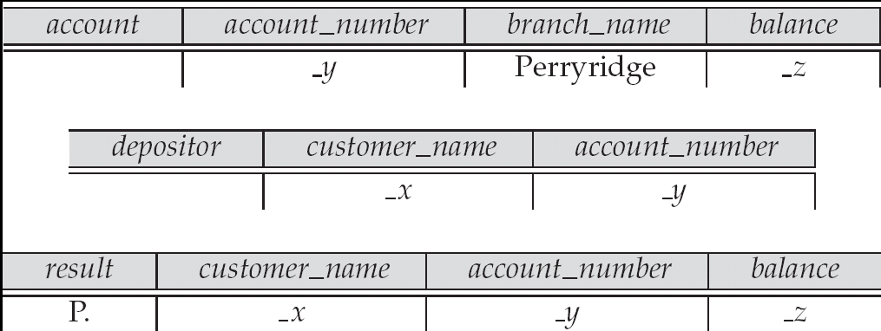
The Result Relation (Cont.)
The resulting query is:

Slide 34
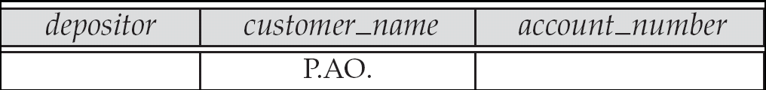
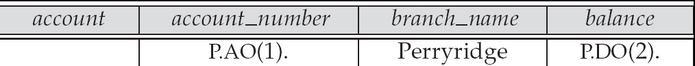
Ordering the Display of Tuples
AO = ascending order; DO = descending order.
Example: list in ascending alphabetical order all customers who have an account at the bank
When sorting on multiple attributes, the sorting order is specified by including with each sort operator (AO or DO) an integer surrounded by parentheses.
Example: List all account numbers at the Perryridge branch in ascending alphabetic order with their respective account balances in descending order.

Slide 35
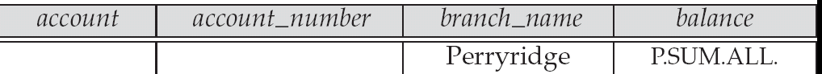
Aggregate Operations
The aggregate operators are AVG, MAX, MIN, SUM, and CNT
The above operators must be postfixed with “ALL” (e.g., SUM.ALL. or AVG.ALL._x) to ensure that duplicates are not eliminated.
Example: Find the total balance of all the accounts maintained at the Perryridge branch.

Slide 36

Aggregate Operations (Cont.)
UNQ is used to specify that we want to eliminate duplicates
Find the total number of customers having an account at the bank.

Slide 37
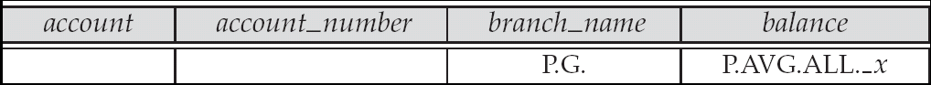
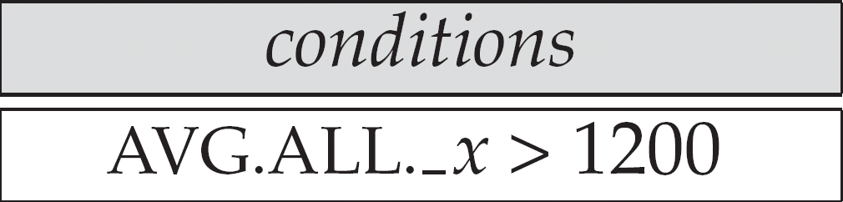
Query Examples
Find the average balance at each branch.
The “G” in “P.G” is analogous to SQL’s group by construct
The “ALL” in the “P.AVG.ALL” entry in the balance column ensures that all balances are considered
To find the average account balance at only those branches where the average account balance is more than $1,200, we simply add the condition box:

Slide 38
Query Example
Find all customers who have an account at all branches located in Brooklyn.
Approach: for each customer, find the number of branches in Brooklyn at which they have accounts, and compare with total number of branches in Brooklyn
QBE does not provide subquery functionality, so both above tasks have to be combined in a single query.
Can be done for this query, but there are queries that require subqueries and cannot always be expressed in QBE.
In the query on the next page
CNT.UNQ.ALL._w specifies the number of distinct branches in Brooklyn. Note: The variable _w is not connected to other variables in the query
CNT.UNQ.ALL._z specifies the number of distinct branches in Brooklyn at which customer x has an account.

Slide 39
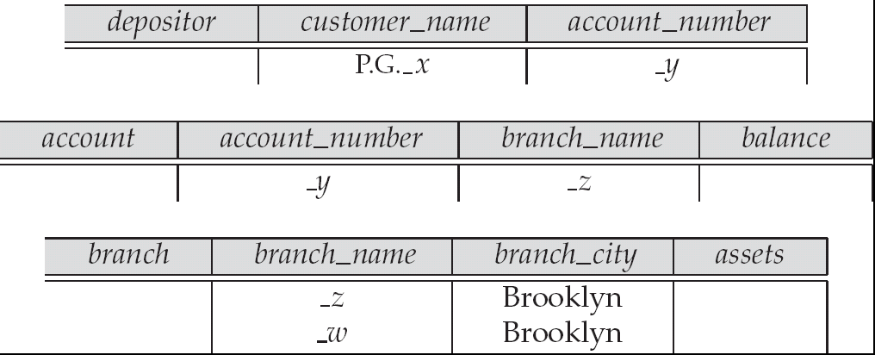
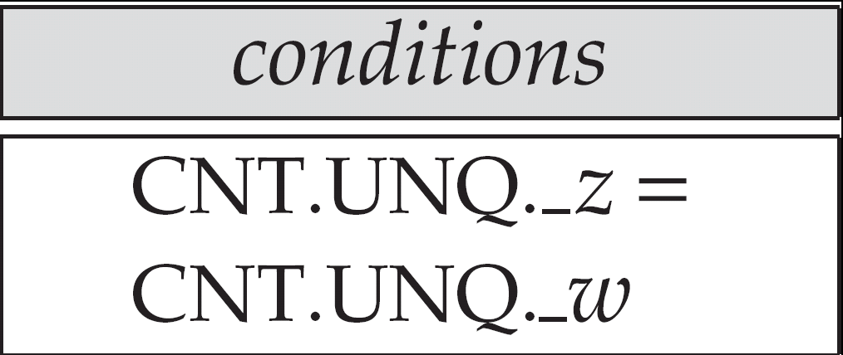
Query Example (Cont.)

Slide 40
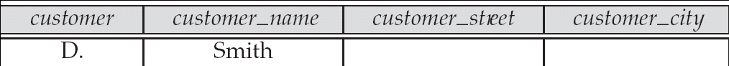
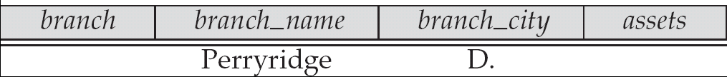
Modification of the Database – Deletion
Deletion of tuples from a relation is expressed by use of a D. command. In the case where we delete information in only some of the columns, null values, specified by –, are inserted.
Delete customer Smith
Delete the branch_city value of the branch whose name is “Perryridge”.

Slide 41
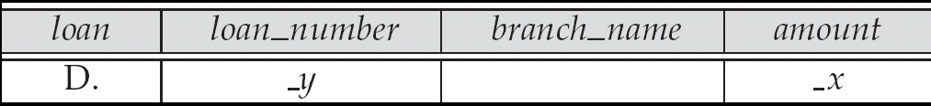
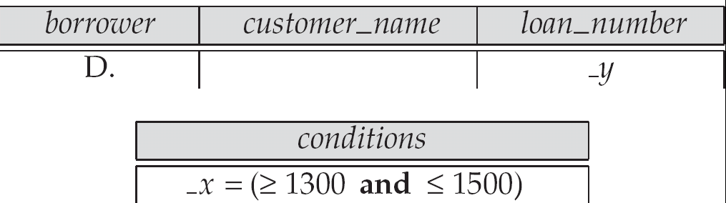
Deletion Query Examples
Delete all loans with a loan amount greater than $1300 and less than $1500.
For consistency, we have to delete information from loan and borrower tables

Slide 42
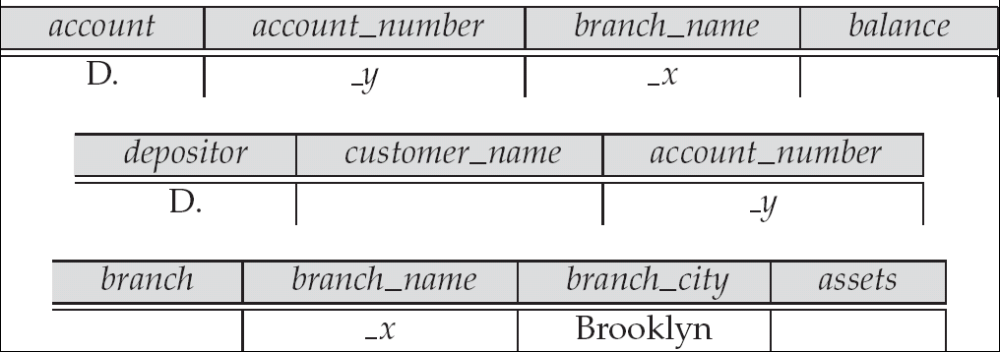
Deletion Query Examples (Cont.)
Delete all accounts at branches located in Brooklyn.

Slide 43
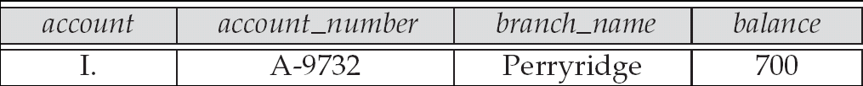
Modification of the Database – Insertion
Insertion is done by placing the I. operator in the query expression.
Insert the fact that account A-9732 at the Perryridge branch has a balance of $700.

Slide 44
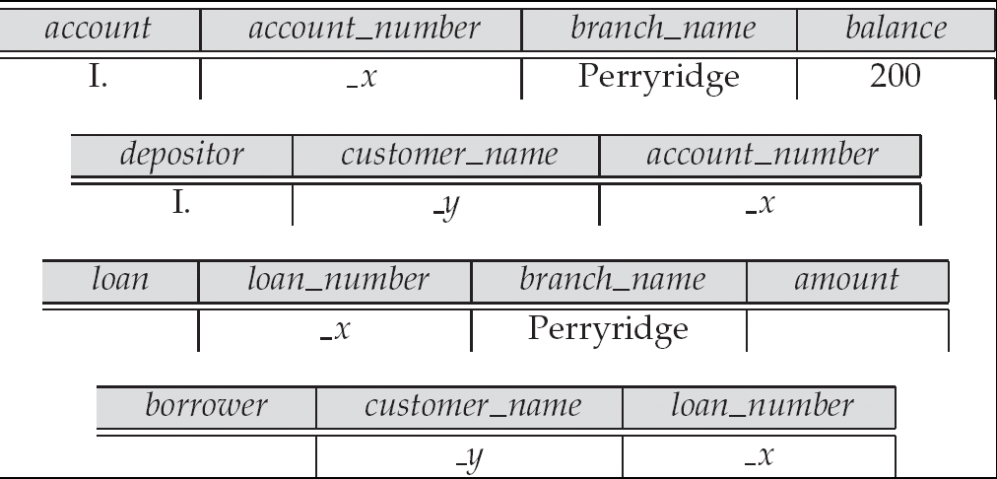
Modification of the Database – Insertion (Cont.)
Provide as a gift for all loan customers of the Perryridge branch, a new $200 savings account for every loan account they have, with the loan number serving as the account number for the new savings account.

Slide 45
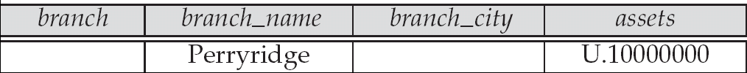
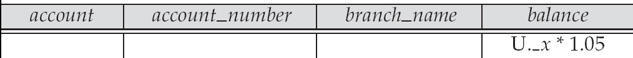
Modification of the Database – Updates
Use the U. operator to change a value in a tuple without changing all values in the tuple. QBE does not allow users to update the primary key fields.
Update the asset value of the Perryridge branch to $10,000,000.
Increase all balances by 5 percent.

Slide 46
Microsoft Access QBE
Microsoft Access supports a variant of QBE called Graphical Query By Example (GQBE)
GQBE differs from QBE in the following ways
Attributes of relations are listed vertically, one below the other, instead of horizontally
Instead of using variables, lines (links) between attributes are used to specify that their values should be the same.
Links are added automatically on the basis of attribute name, and the user can then add or delete links
By default, a link specifies an inner join, but can be modified to specify outer joins.
Conditions, values to be printed, as well as group by attributes are all specified together in a box called the design grid

Slide 47
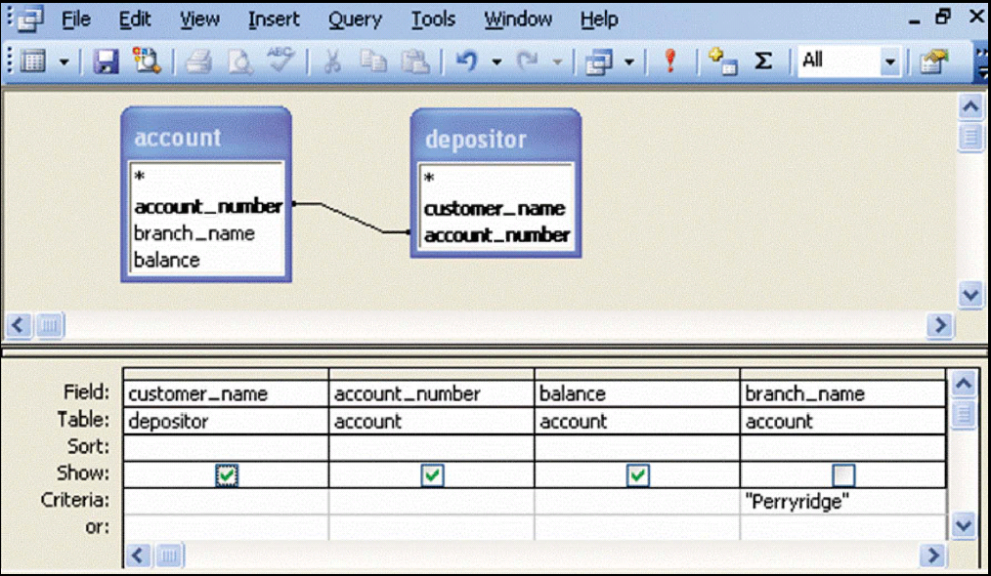
An Example Query in Microsoft Access QBE
Example query: Find the customer_name, account_number and balance for all accounts at the Perryridge branch

Slide 48
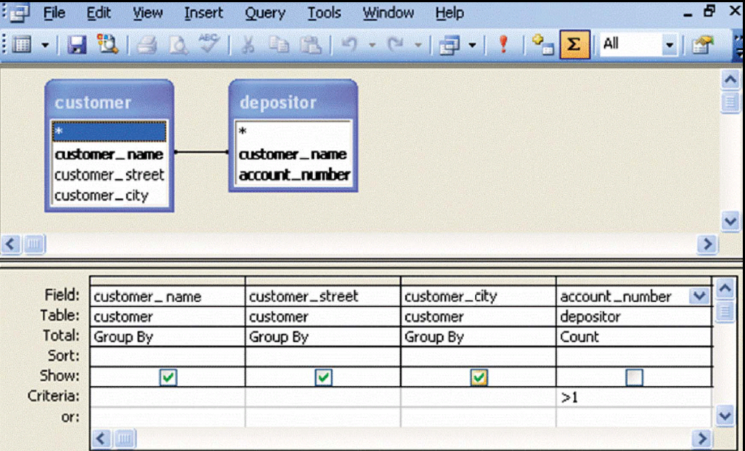
An Aggregation Query in Access QBE
Find the name, street and city of all customers who have more than one account at the bank

Slide 49
Aggregation in Access QBE
The row labeled Total specifies
which attributes are group by attributes
which attributes are to be aggregated upon (and the aggregate function).
For attributes that are neither group by nor aggregated, we can still specify conditions by selecting where in the Total row and listing the conditions below
As in SQL, if group by is used, only group by attributes and aggregate results can be output

Slide 50
Datalog
Basic Structure
Syntax of Datalog Rules
Semantics of Nonrecursive Datalog
Safety
Relational Operations in Datalog
Recursion in Datalog
The Power of Recursion

Slide 51
Basic Structure
Prolog-like logic-based language that allows recursive queries; based on first-order logic.
A Datalog program consists of a set of rules that define views.
Example: define a view relation v1 containing account numbers and balances for accounts at the Perryridge branch with a balance of over $700.
v1 (A, B ) :– account (A, “Perryridge”, B ), B > 700.
Retrieve the balance of account number “A-217” in the view relation v1.
? v1 (“A-217”, B ).
To find account number and balance of all accounts in v1 that have a balance greater than 800 ? v1 (A,B ), B > 800

Slide 52
Example Queries
Each rule defines a set of tuples that a view relation must contain.
E.g. v1 (A, B ) :– account (A, “ Perryridge”, B ), B > 700 is read as
for all A, B
if (A, “Perryridge”, B ) ∈ account and B > 700
then (A, B ) ∈ v1
The set of tuples in a view relation is then defined as the union of all the sets of tuples defined by the rules for the view relation.
Example:
interest_rate (A, 5) :– account (A, N, B ) , B < 10000 interest_rate (A, 6) :– account (A, N, B ), B >= 10000

Slide 53
Negation in Datalog
Define a view relation c that contains the names of all customers who have a deposit but no loan at the bank:
c(N) :– depositor (N, A), not is_borrower (N). is_borrower (N) :–borrower (N,L).
NOTE: using not borrower (N, L) in the first rule results in a different meaning, namely there is some loan L for which N is not a borrower.
To prevent such confusion, we require all variables in negated “predicate” to also be present in non-negated predicates

Slide 54
Named Attribute Notation
Datalog rules use a positional notation that is convenient for relations with a small number of attributes
It is easy to extend Datalog to support named attributes.
E.g., v1 can be defined using named attributes as
v1 (account_number A, balance B ) :– account (account_number A, branch_name “ Perryridge”, balance B ), B > 700.

Slide 55
Formal Syntax and Semantics of Datalog
We formally define the syntax and semantics (meaning) of Datalog programs, in the following steps
We define the syntax of predicates, and then the syntax of rules
We define the semantics of individual rules
We define the semantics of non-recursive programs, based on a layering of rules
It is possible to write rules that can generate an infinite number of tuples in the view relation. To prevent this, we define what rules are “safe”. Non-recursive programs containing only safe rules can only generate a finite number of answers.
It is possible to write recursive programs whose meaning is unclear. We define what recursive programs are acceptable, and define their meaning.

Slide 56
Syntax of Datalog Rules
A positive literal has the form
p (t₁, t₂ ..., t_{n} )
p is the name of a relation with n attributes
each t_{i} is either a constant or variable
A negative literal has the form
not p (t₁, t₂ ..., t_{n} )
Comparison operations are treated as positive predicates
E.g. X > Y is treated as a predicate >(X,Y )
“>” is conceptually an (infinite) relation that contains all pairs of values such that the first value is greater than the second value
Arithmetic operations are also treated as predicates
E.g. A = B + C is treated as +(B, C, A), where the relation “+” contains all triples such that the third value is the sum of the first two

Slide 57
Syntax of Datalog Rules (Cont.)
Rules are built out of literals and have the form:
p (t₁, t₂, ..., t_{n} ) :– L₁, L₂, ..., L_{m}.
head body
each L_{i} is a literal
head – the literal p (t₁, t₂, ..., t_{n} )
body – the rest of the literals
A fact is a rule with an empty body, written in the form:
p (v₁, v₂, ..., v_{n} ).
indicates tuple (v₁, v₂, ..., v_{n} ) is in relation p
A Datalog program is a set of rules

Slide 58
Semantics of a Rule
A ground instantiation of a rule (or simply instantiation) is the result of replacing each variable in the rule by some constant.
Eg. Rule defining v1
v1(A,B) :– account (A,“Perryridge”, B ), B > 700.
An instantiation above rule:
v1 (“A-217”, 750) :–account ( “A-217”, “Perryridge”, 750), 750 > 700.
The body of rule instantiation R’ is satisfied in a set of facts (database instance) l if
1. For each positive literal q_{i} (v_{i,1}, ..., v_{i,ni} ) in the body of R’, l contains the fact q_{i} (v_{i,1}, ..., v_{i,ni} ).
2. For each negative literal not q_{j} (v_{j,1}, ..., v_{j,nj} ) in the body of R’, l does not contain the fact q_{j} (v_{j,1}, ..., v_{j,nj} ).

Slide 59
Semantics of a Rule (Cont.)
We define the set of facts that can be inferred from a given set of facts l using rule R as:
infer(R, l) = { p (t₁, ..., t_{n}) | there is a ground instantiation R’ of R where p (t₁, ..., t_{n} ) is the head of R’, and the body of R’ is satisfied in l }
Given an set of rules ℜ = {R₁, R₂, ..., R_{n}}, we define
infer(ℜ, l) = infer (R₁, l ) ∪ infer (R₂, l ) ∪ ... ∪ infer (R_{n}, l )

Slide 60
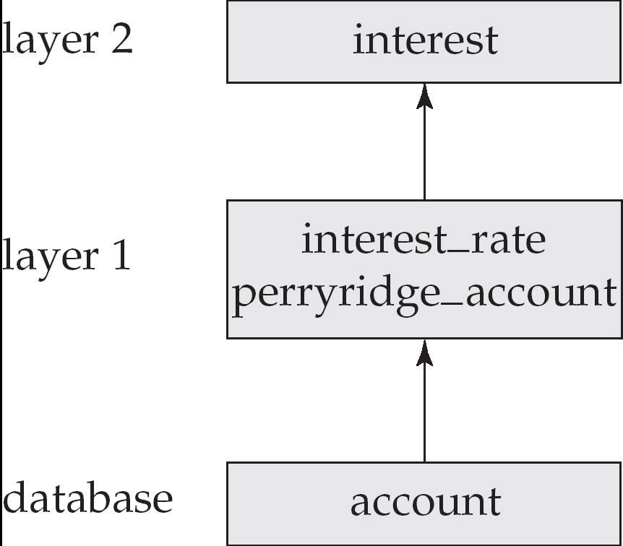
Layering of Rules
Define the interest on each account in Perryridge
interest(A, l) :– perryridge_account (A,B), interest_rate(A,R), l = B * R/100. perryridge_account(A,B) :– account (A, “Perryridge”, B). interest_rate (A,5) :– account (N, A, B), B < 10000. interest_rate (A,6) :– account (N, A, B), B >= 10000.
Layering of the view relations

Slide 61
Layering Rules (Cont.)
Formally:
A relation is a layer 1 if all relations used in the bodies of rules defining it are stored in the database.
A relation is a layer 2 if all relations used in the bodies of rules defining it are either stored in the database, or are in layer 1.
A relation p is in layer i + 1 if
it is not in layers 1, 2, ..., i
all relations used in the bodies of rules defining a p are either stored in the database, or are in layers 1, 2, ..., i

Slide 62
Semantics of a Program
Let the layers in a given program be 1, 2, ..., n. Let ℜ_{i} denote the
set of all rules defining view relations in layer i.
Define I₀ = set of facts stored in the database.
Recursively define l_{i+1} = l_{i} ∪ infer (ℜ_{i+1}, l_{i} )
The set of facts in the view relations defined by the program (also called the semantics of the program) is given by the set of facts l_{n} corresponding to the highest layer n.
Note: Can instead define semantics using view expansion like
in relational algebra, but above definition is better for handling
extensions such as recursion.

Slide 63
Safety
It is possible to write rules that generate an infinite number of answers.
gt(X, Y) :– X > Y not_in_loan (B, L) :– not loan (B, L)
To avoid this possibility Datalog rules must satisfy the following conditions.
Every variable that appears in the head of the rule also appears in a non-arithmetic positive literal in the body of the rule.
This condition can be weakened in special cases based on the semantics of arithmetic predicates, for example to permit the rule p (A ) :- q (B ), A = B + 1
Every variable appearing in a negative literal in the body of the rule also appears in some positive literal in the body of the rule.

Slide 64
Relational Operations in Datalog
Project out attribute account_name from account.
query (A) :–account (A, N, B ).
Cartesian product of relations r₁ and r₂.
query (X₁, X₂, ..., X_{n}, Y₁, Y₁, Y₂, ..., Y_{m} ) :– r₁ (X₁, X₂, ..., X_{n} ), r₂ (Y₁, Y₂, ..., Y_{m} ).
Union of relations r₁ and r₂.
query (X₁, X₂, ..., X_{n} ) :–r₁ (X₁, X₂, ..., X_{n} ), query (X₁, X₂, ..., X_{n} ) :–r₂ (X₁, X₂, ..., X_{n} ),
Set difference of r₁ and r₂.
query (X₁, X₂, ..., X_{n} ) :–r₁(X₁, X₂, ..., X_{n} ), not r₂ (X₁, X₂, ..., X_{n} ),

Slide 65
Recursion in Datalog
Suppose we are given a relation manager (X, Y ) containing pairs of names X, Y such that Y is a manager of X (or equivalently, X is a direct employee of Y).
Each manager may have direct employees, as well as indirect employees
Indirect employees of a manager, say Jones, are employees of people who are direct employees of Jones, or recursively, employees of people who are indirect employees of Jones
Suppose we wish to find all (direct and indirect) employees of manager Jones. We can write a recursive Datalog program.
empl_jones (X ) :- manager (X, Jones ).
empl_jones (X ) :- manager (X, Y ), empl_jones (Y ).

Slide 66
Semantics of Recursion in Datalog
Assumption (for now): program contains no negative literals
The view relations of a recursive program containing a set of rules ℜ are defined to contain exactly the set of facts l computed by the iterative procedure Datalog-Fixpoint
procedure Datalog-Fixpoint l = set of facts in the database repeat Old_l = l l = l ∪ infer (ℜ, l )
until l = Old_l
At the end of the procedure, infer (ℜ, l ) ⊆ l
Infer (ℜ, l ) = l if we consider the database to be a set of facts that are part of the program
l is called a fixed point of the program.

Slide 67
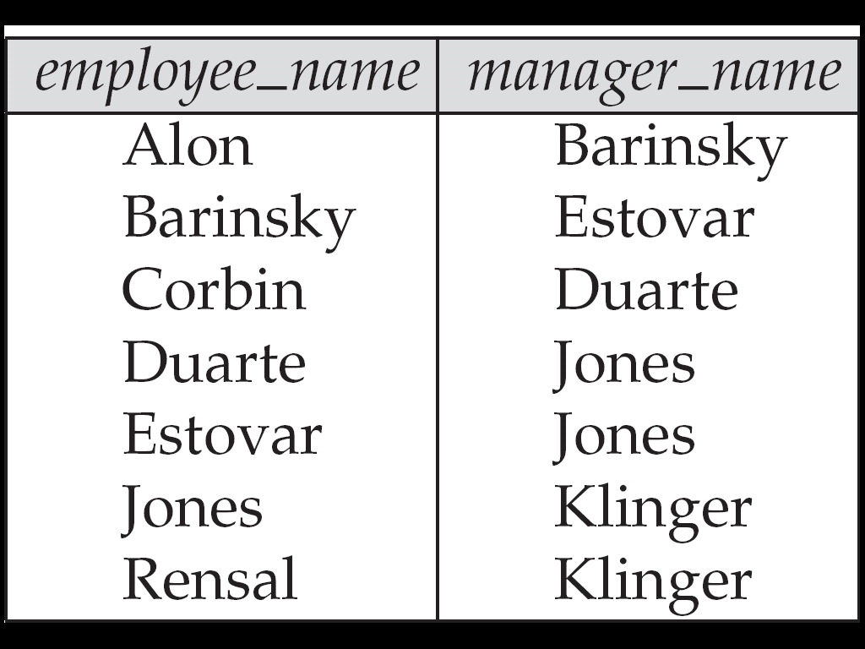
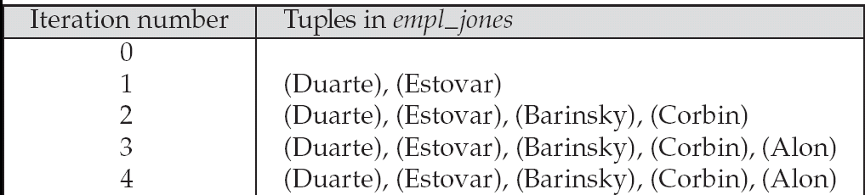
Example of Datalog-FixPoint Iteration

Slide 68
A More General View
Create a view relation empl that contains every tuple (X, Y ) such that X is directly or indirectly managed by Y.
empl (X, Y ) :– manager (X, Y ). empl (X, Y ) :– manager (X, Z ), empl (Z, Y )
Find the direct and indirect employees of Jones.
? empl (X, “Jones”).
Can define the view empl in another way too:
empl (X, Y ) :– manager (X, Y ). empl (X, Y ) :– empl (X, Z ), manager (Z, Y ).

Slide 69
The Power of Recursion
Recursive views make it possible to write queries, such as transitive closure queries, that cannot be written without recursion or iteration.
Intuition: Without recursion, a non-recursive non-iterative program can perform only a fixed number of joins of manager with itself
This can give only a fixed number of levels of managers
Given a program we can construct a database with a greater number of levels of managers on which the program will not work

Slide 70
Recursion in SQL
Starting with SQL:1999, SQL permits recursive view definition
E.g. query to find all employee-manager pairs with recursive empl (emp, mgr ) as ( select emp, mgr from manager union select manager.emp, empl.mgr from manager, empl where manager.mgr = empl.emp ) select * from empl

Slide 71
Monotonicity
A view V is said to be monotonic if given any two sets of facts I₁ and I₂ such that l₁ ⊆ I₂, then E_{v} (I₁) ⊆ E_{v} (I₂ ), where E_{v} is the expression used to define V.
A set of rules R is said to be monotonic if l₁ ⊆ I₂ implies infer (R, I₁ ) ⊆ infer (R, I₂ ),
Relational algebra views defined using only the operations: ∏, σ, ×, ∪, |X|, ∩, and ρ (as well as operations like natural join defined in terms of these operations) are monotonic.
Relational algebra views defined using set difference (–) may not be monotonic.
Similarly, Datalog programs without negation are monotonic, but Datalog programs with negation may not be monotonic.

Slide 72
Non-Monotonicity
Procedure Datalog-Fixpoint is sound provided the rules in the program are monotonic.
Otherwise, it may make some inferences in an iteration that cannot be made in a later iteration. E.g. given the rules a :- not b. b :- c. c.
Then a can be inferred initially, before b is inferred, but not later.
We can extend the procedure to handle negation so long as the program is “stratified”: intuitively, so long as negation is not mixed with recursion

Slide 73
Non-Monotonicity (Cont.)
There are useful queries that cannot be expressed by a stratified program
Example: given information about the number of each subpart in each part, in a part-subpart hierarchy, find the total number of subparts of each part.
A program to compute the above query would have to mix aggregation with recursion
However, so long as the underlying data (part-subpart) has no cycles, it is possible to write a program that mixes aggregation with recursion, yet has a clear meaning
There are ways to evaluate some such classes of non-stratified programs

Slide 74
End of Chapter 5

Slide 75
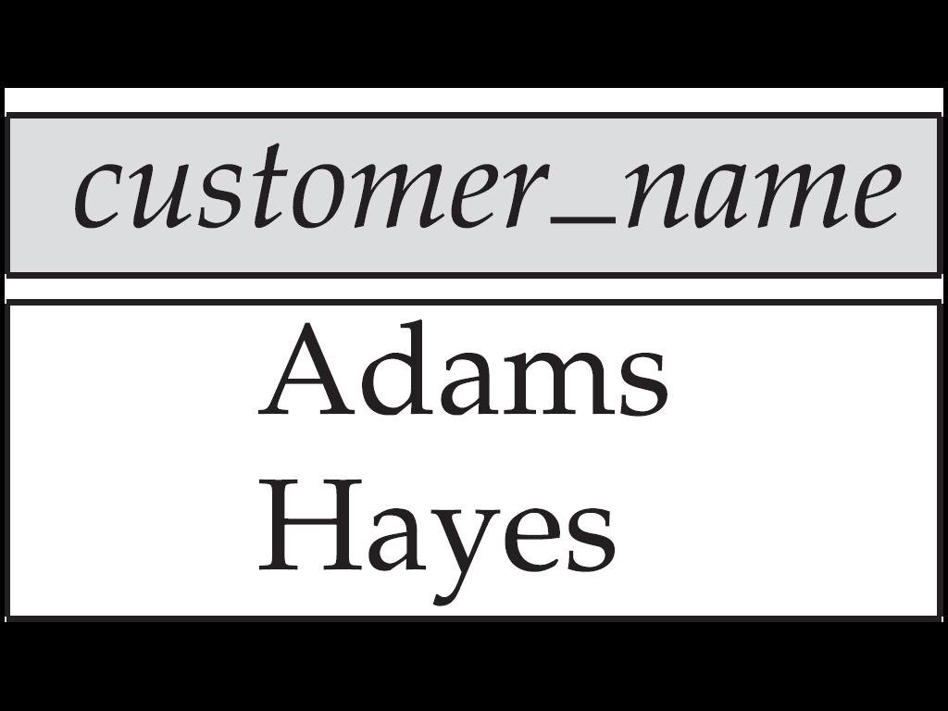
Figure 5.1

Slide 76
Figure 5.2

Slide 77
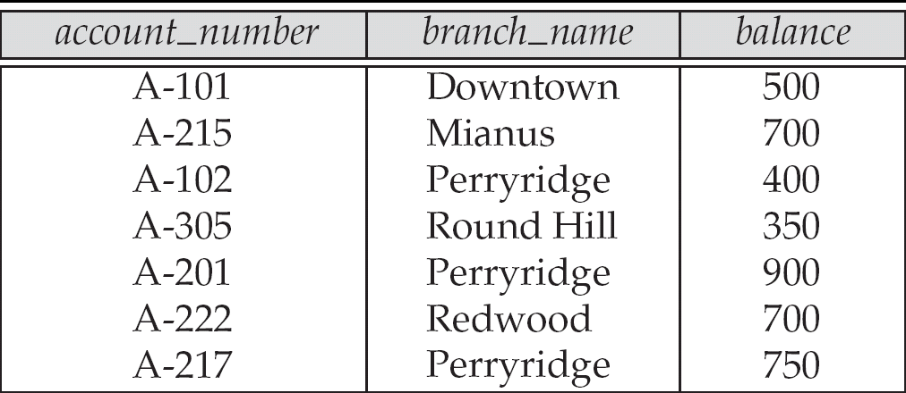
Figure 5.5

Slide 78
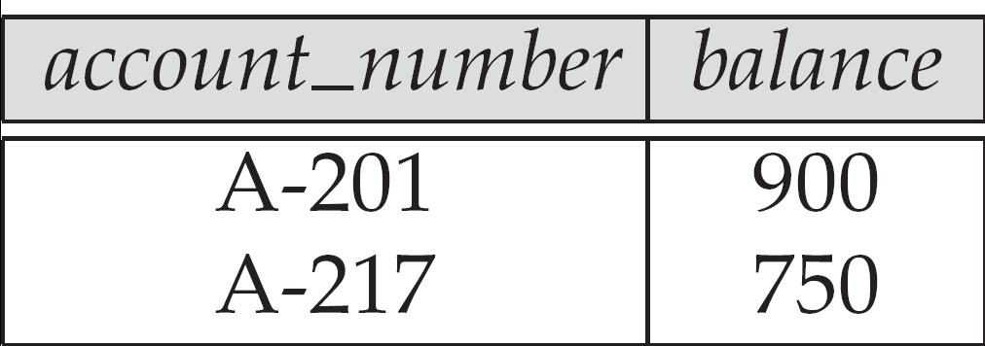
Figure 5.6

Slide 79

Figure 5.9

Slide 80

Figure in-5.2

Slide 81
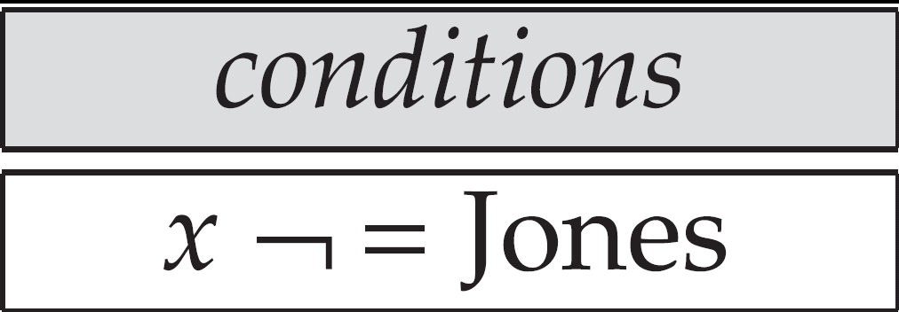
Figure in-5.15

Slide 82
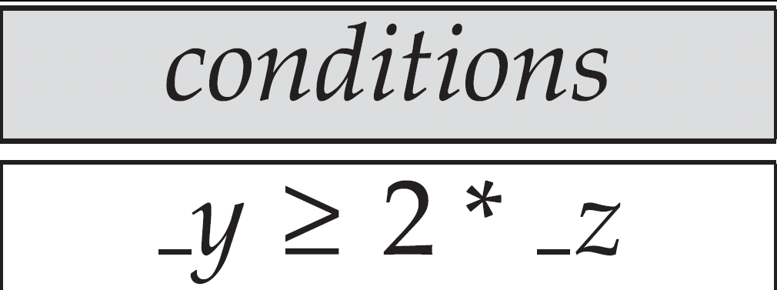
Figure in-5.18

Slide 83
Figure in-5-31

Slide 84
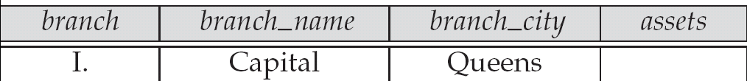
Figure in-5.36

